Slide 1

现象驱动的理论研究—Artificial Neural Science
许志钦
Shanghai Jiao Tong University
Monday, November 20, 2023

Slide 2
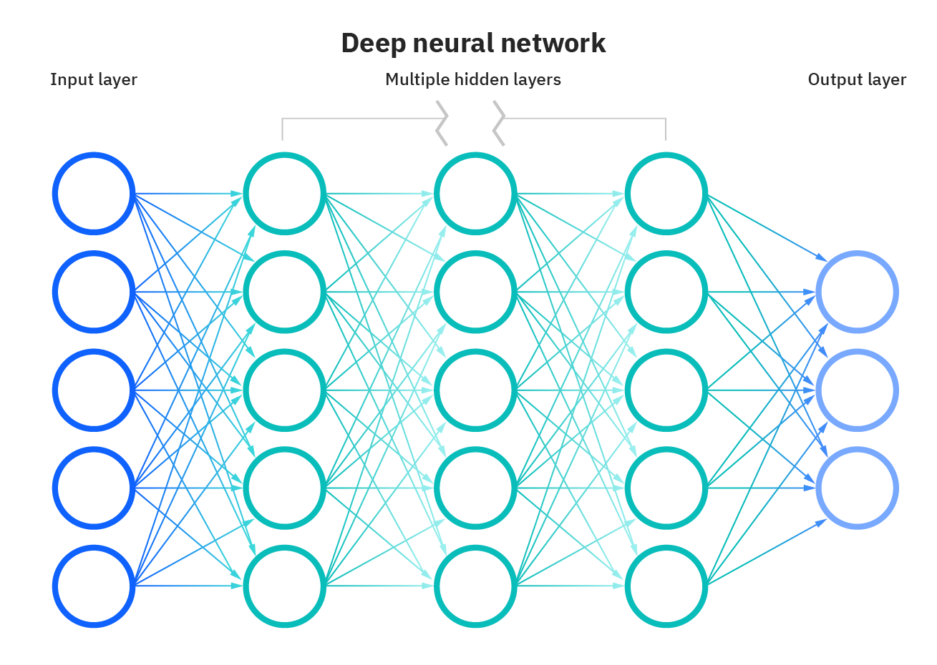
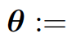
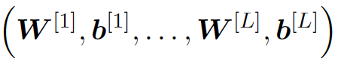
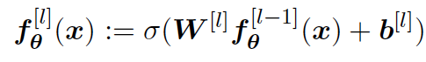

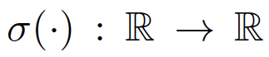
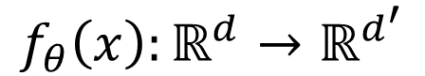
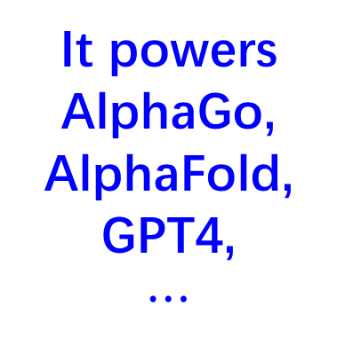
“平平无奇”的深度神经网络（DNN）
It powers
AlphaGo, AlphaFold,
GPT4,
$$⋯$$
$$f_{θ}\left(x\right):ℝ^{d}→ℝ^{d^{′}}$$
https://www.ibm.com/cloud/learn/neural-networks

Slide 3
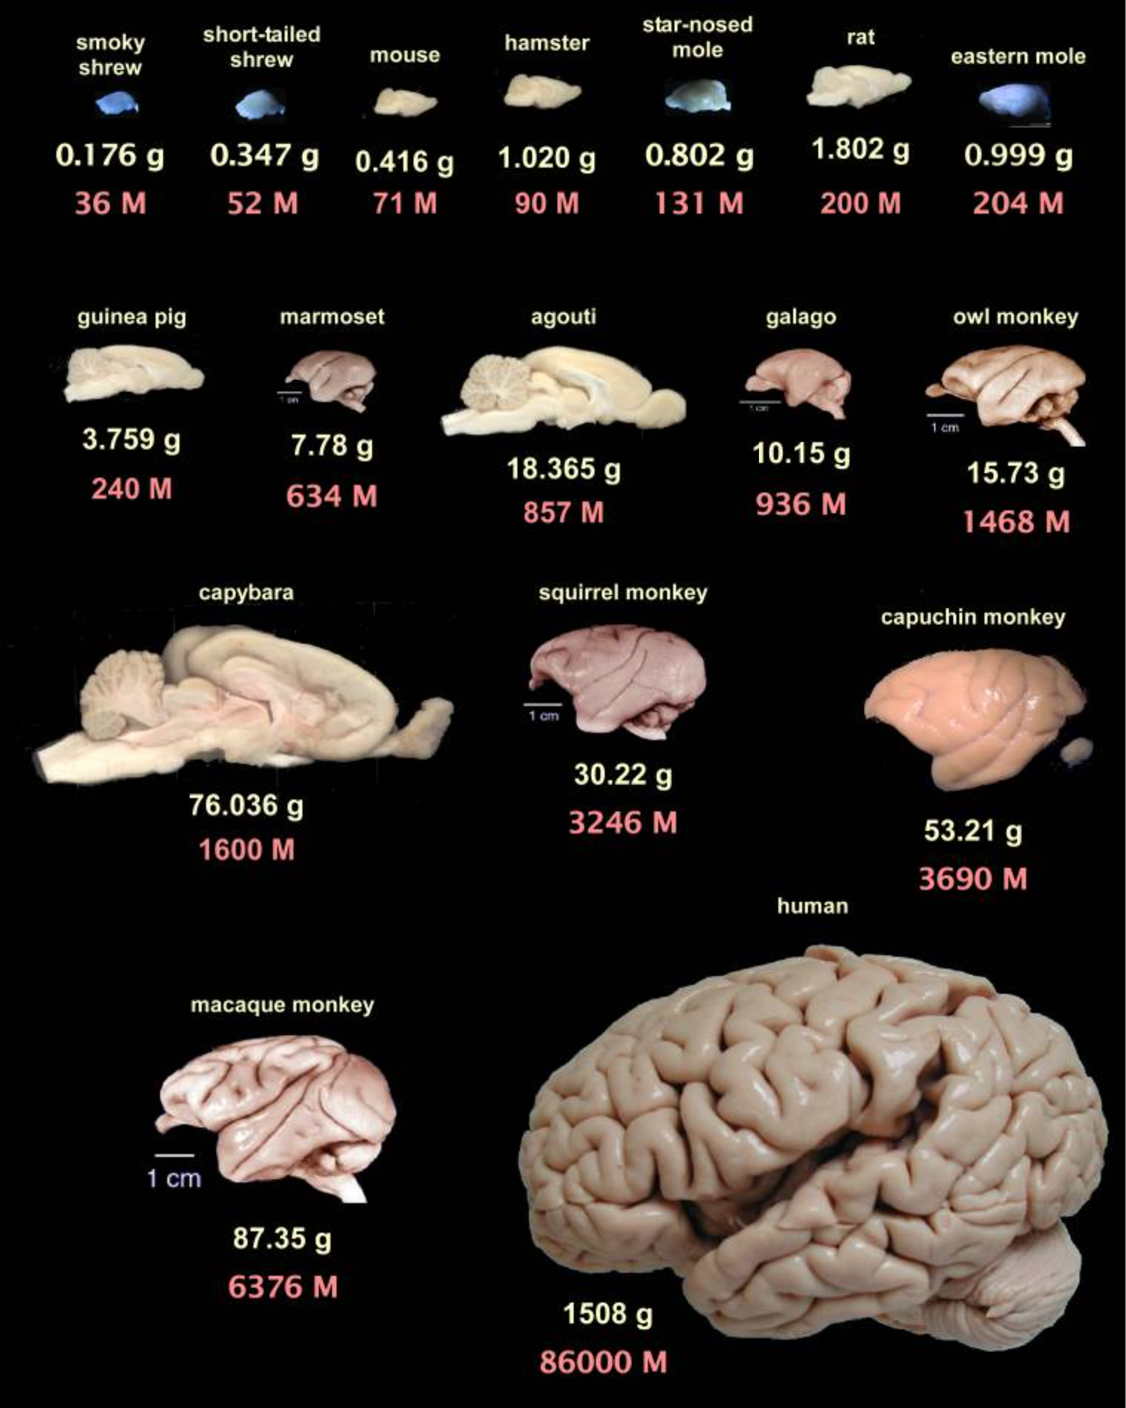
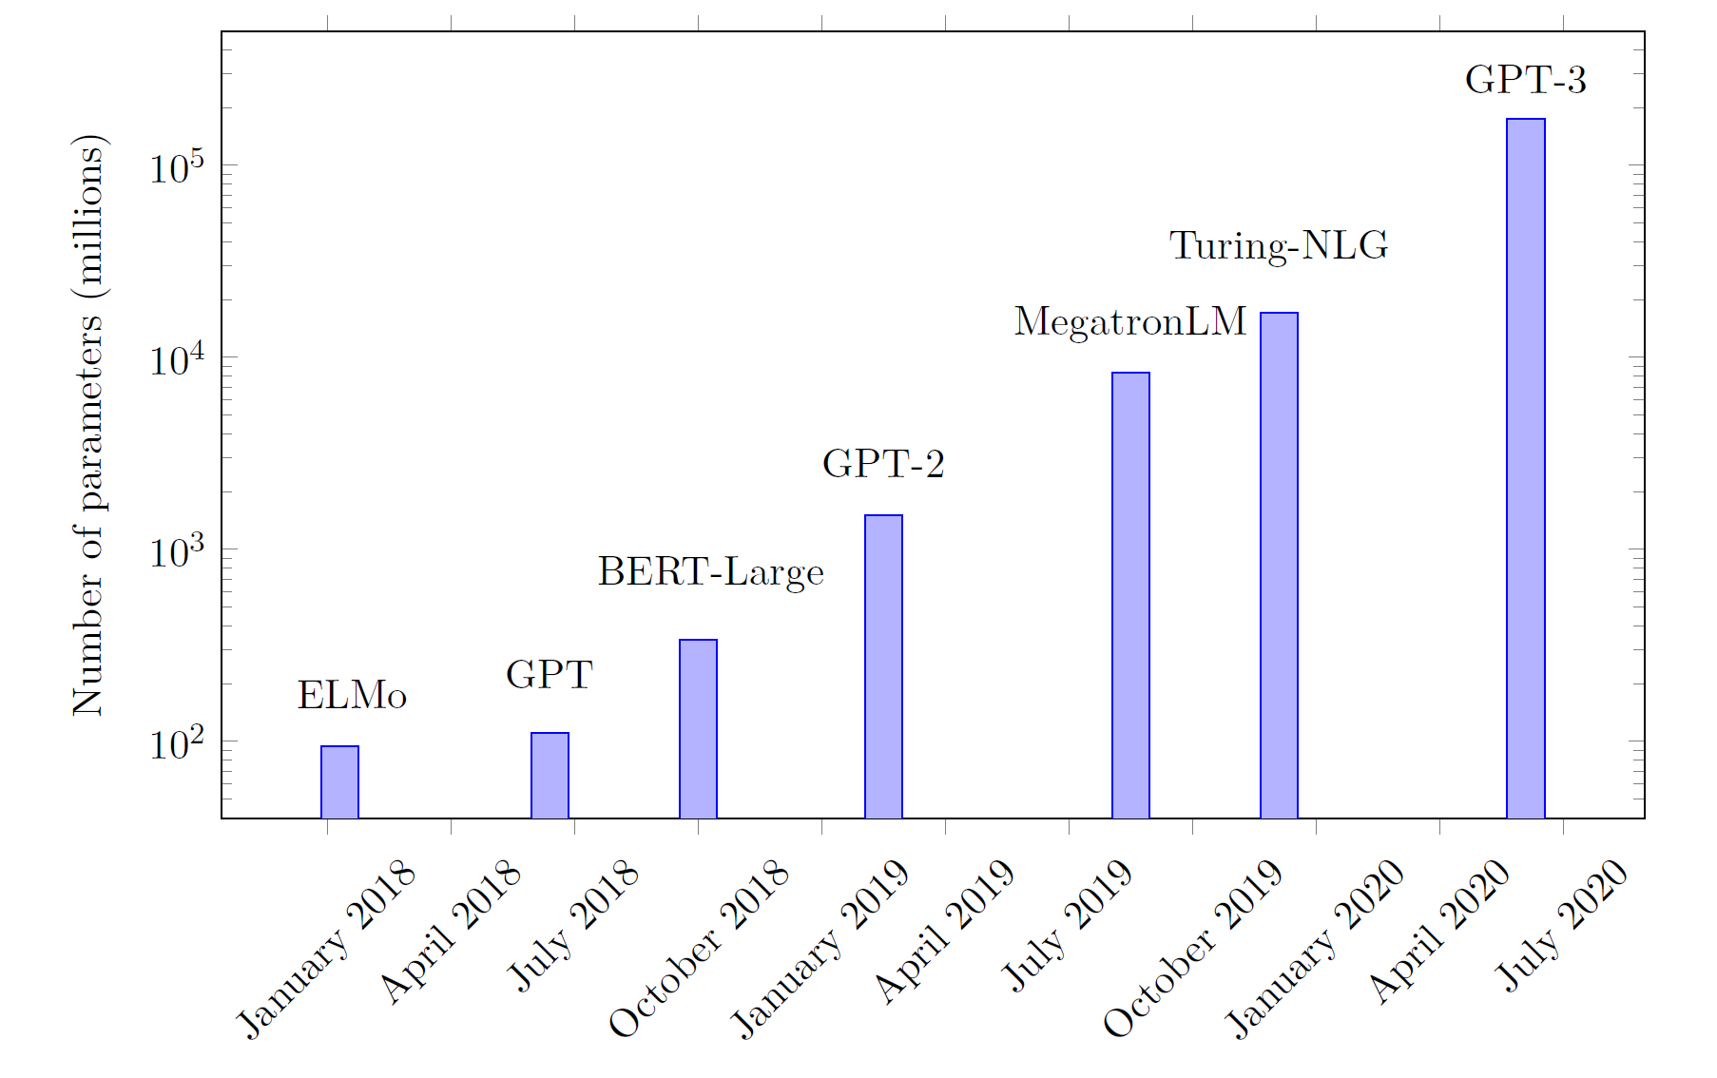
神经网络越来越大
Guillaume Hocquet. Class Incremental Continual Learning in Deep Neural Networks. Université Paris-Saclay, 2021
Suzana Herculano-Houzel, 2009

Slide 4
为什么要发展理论
热力学第一定律：能量守恒
第一类永动机不可能，避免浪费精力
热力学第二定律：不可能从单一热源吸收能量，使之完全变为有用功而不产生其他影响。
第二类永动机不可能，避免浪费精力
化学
炼金术，把铜炼成金不可能，避免浪费精力
把木碳变成钻石 （高温高压）是可能的
理解DNN擅长什么和什么是困难的
例子：高频是困难的
问题：涌现是否一定要大模型、大数据

Slide 5
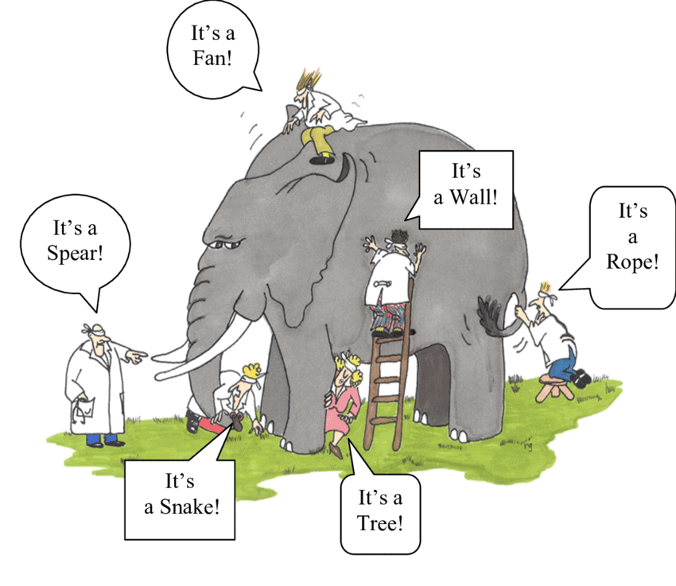
DNN理论研究现状
Generalization at overparameterization
Frequency Principle (spectral bias)
Condensation
Lazy training
Double descent
Edge of stability
Lottery ticket
……
如果我们是盲人，我们该怎么“摸象”？
https://www.sloww.co/blind-men-elephant/

Slide 6
正确的摸象姿势
抵制：
对局部认识的夸大
不关心现象细节的理论
应该：
细究局部、关注整体、分辨主次，
以扎实的现象研究为基础建立理论。
扎实的现象研究：
这是一堵墙 → 它中央的一部分大而厚实
这是一根绳子 → 它后方的一部分又细又长
这是一棵树 → 它下方有四根粗壮的柱形物支撑
……
https://www.sloww.co/blind-men-elephant/

Slide 7
好的理论有哪些特点
基本条件：
问题重要：发现或者研究有趣的现象或者理论问题
可分析：简单到可以分析，但又复杂到可以对关心的现象或问题提供理解
可验证：可以被实验验证
高级条件
引出更多有意思的现象或者理论问题帮助我们更深入理解
指导实际算法的设计

Slide 8
有意思的现象

Slide 9

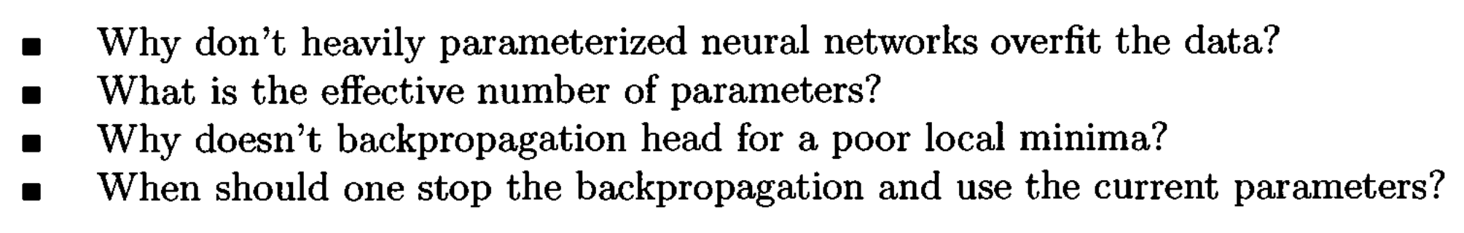
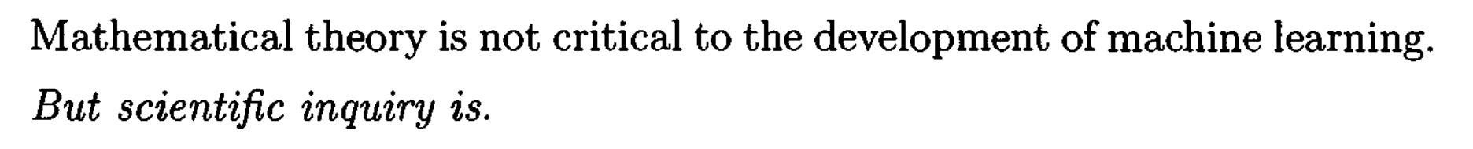
Long-standing problems
1995

Slide 10
Overparameterization puzzle

Slide 11
Is NN really so complex?

Slide 12
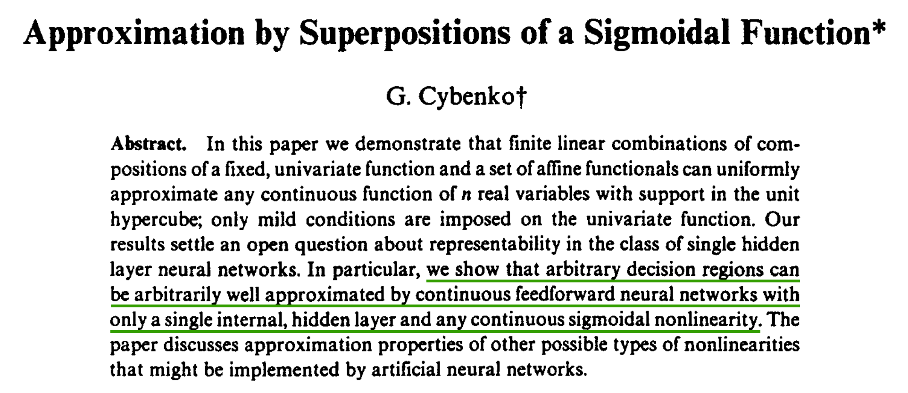
1989
Yes, NN is complex!

Slide 13
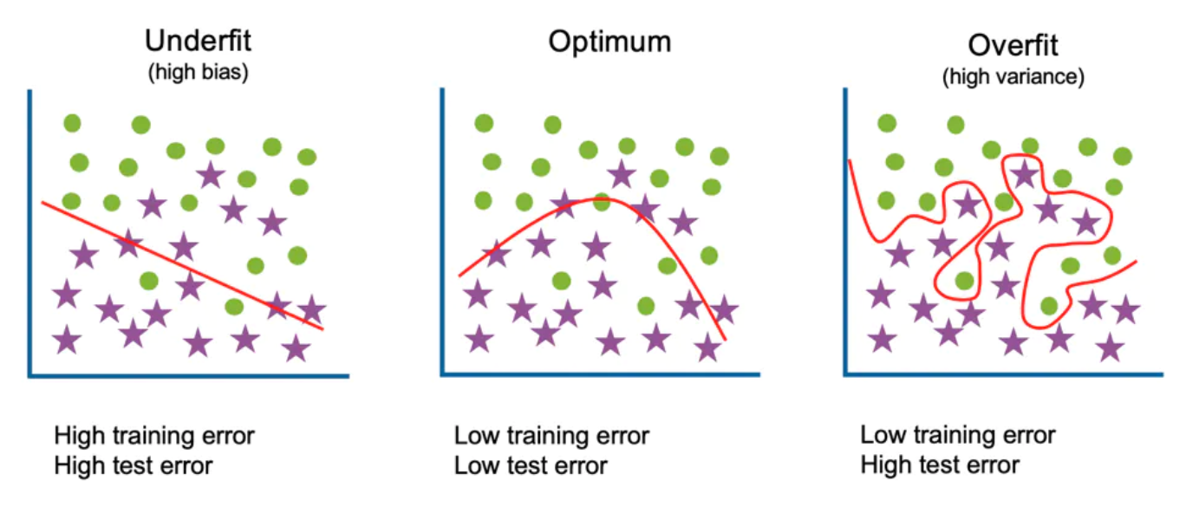
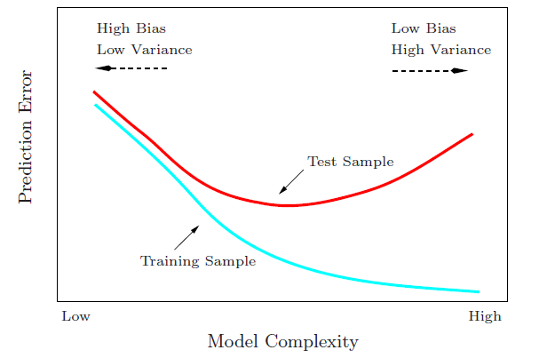
Start from traditional generalization gap
Large complexity → Large generalization gap
Generalization Gap
Traditional wisdom: Too complex is trouble

Slide 14
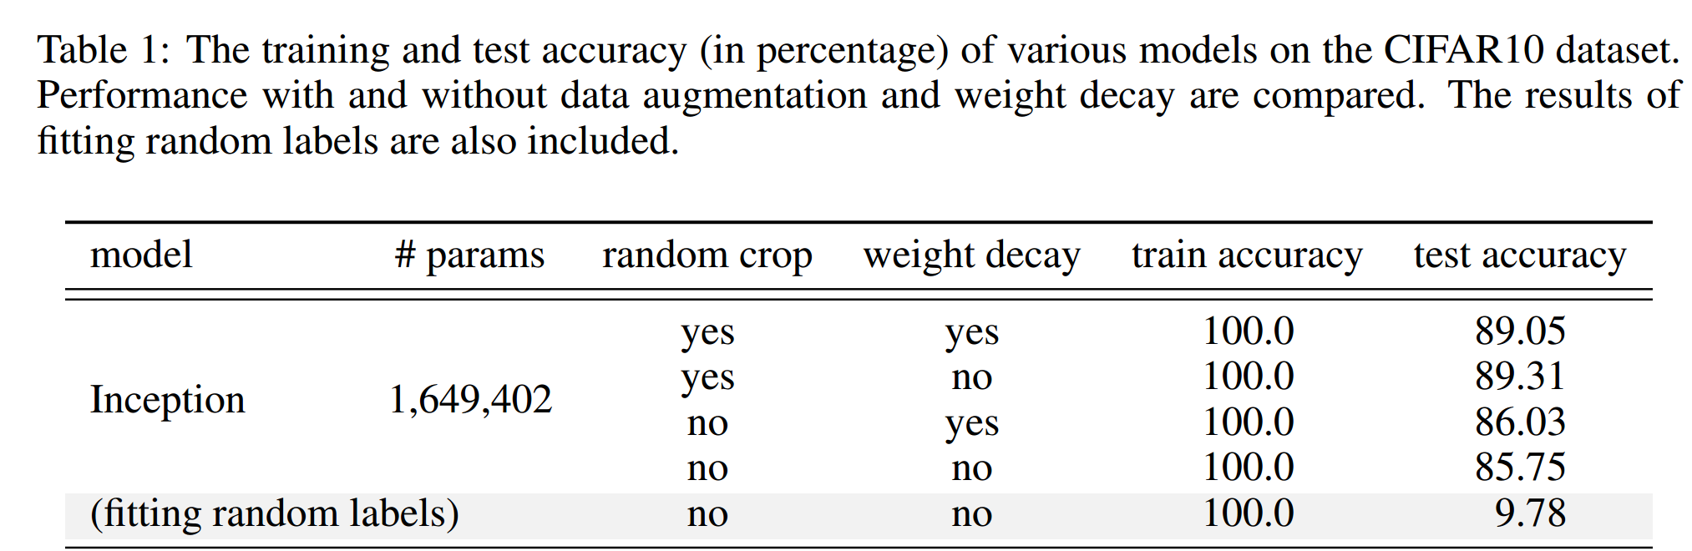
Overparameterization puzzle
Puzzle: generalize well even # of para >> # of training data
60000 32x32 colour images in 10 classes
This trouble ignores deep learning?
L. Breiman 1995, Zhang et al., 2016

Slide 15
Frequency Principle

Slide 16
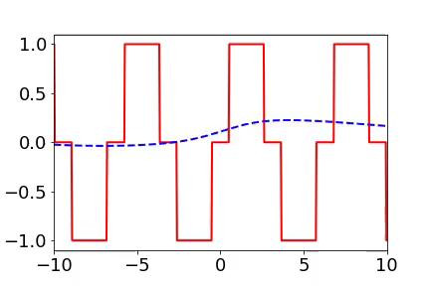
Training process of 1d example in spatial domain
From landscape to detail
Red:
target function
Blue:
DNN fitting
[1] Xu*, Zhang, Xiao, 1807.01251, ICONIP, [2] Xu*, Zhang, Luo, Xiao, Ma, 1901.06523, CiCP

Slide 17
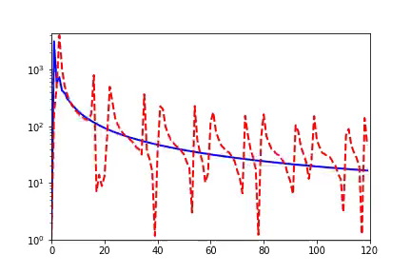
Training process of 1d example in Fourier domain
Frequency principle: From low frequency to high frequency
Red:
target function
Blue:
DNN fitting
Amplitude
Frequency
[1] Xu*, Zhang, Xiao, 1807.01251, ICONIP, [2] Xu*, Zhang, Luo, Xiao, Ma, 1901.06523, CiCP

Slide 18
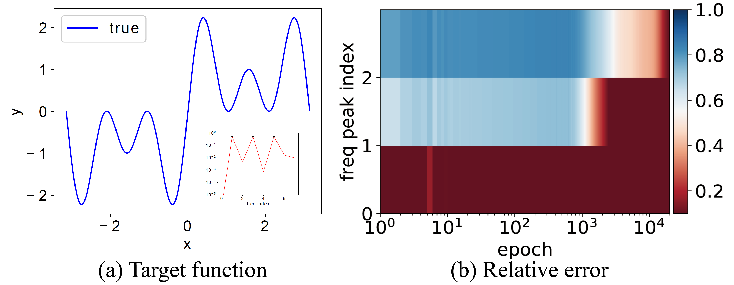
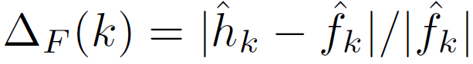
Important problems in this field
Equal amplitudes
$$f\left(x\right)=\sin{x}+\sin{3x}+\sin{5x}$$
1901.06523

Slide 19
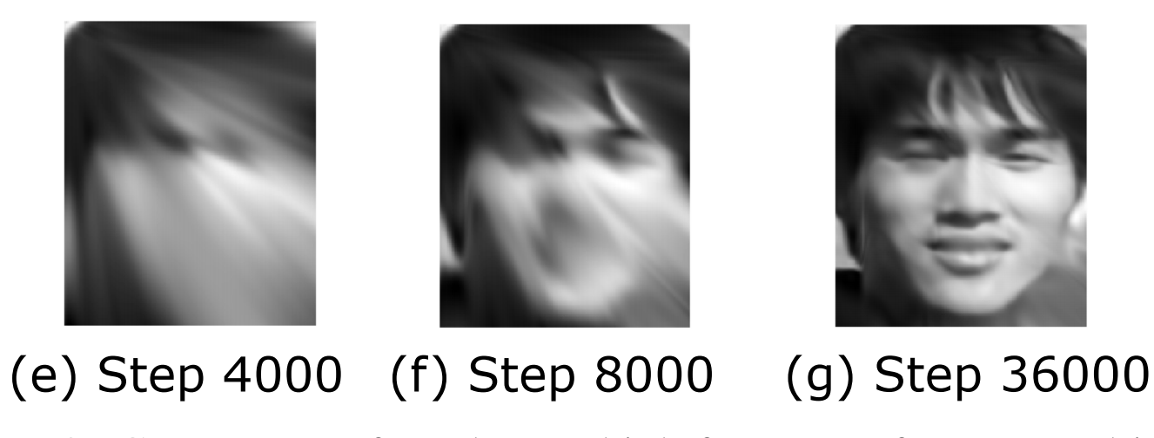
2d data

Slide 20
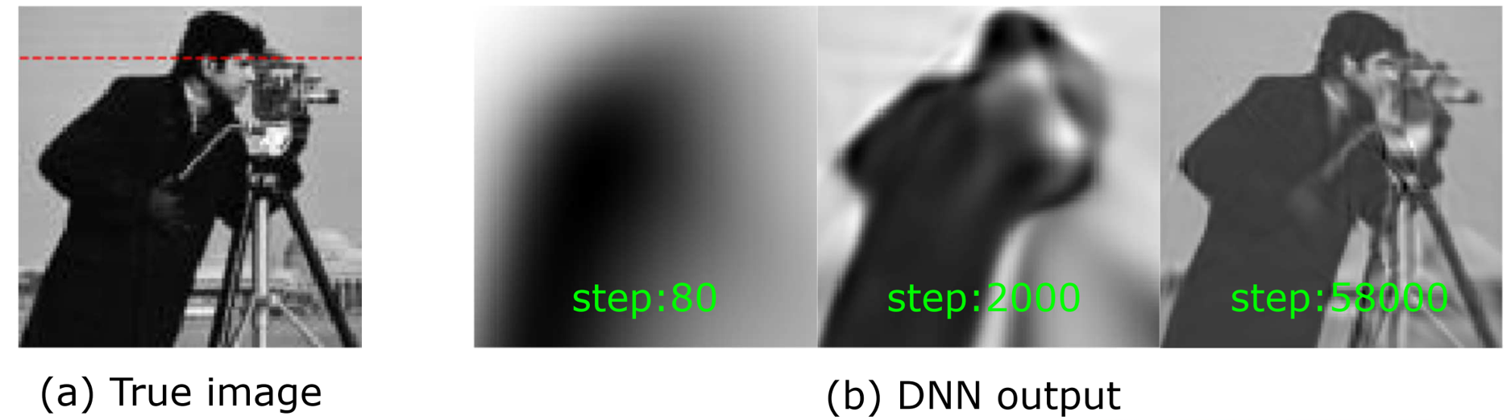
2d data
Xu*, Zhang, Luo, Xiao, Ma, 1901.06523, CiCP

Slide 21
Lottery ticket hypothesis

Slide 22
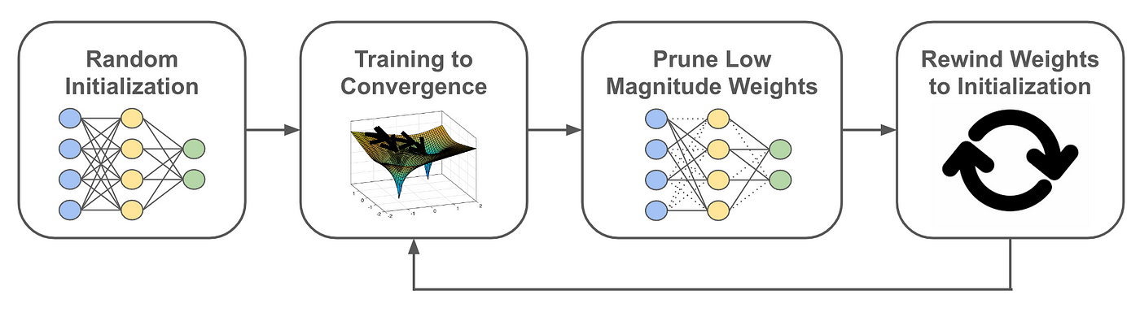
Lottery ticket hypothesis

Slide 23
Edge of stability

Slide 24
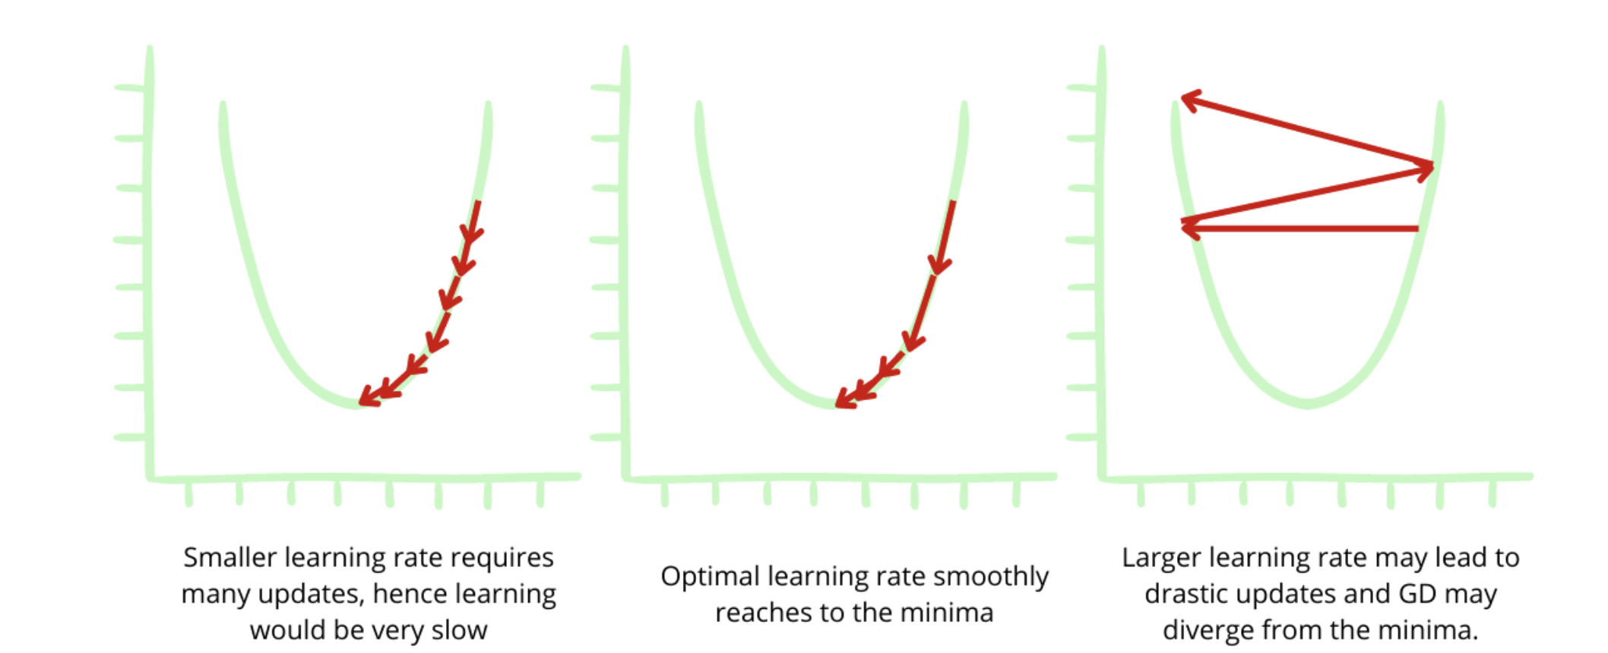
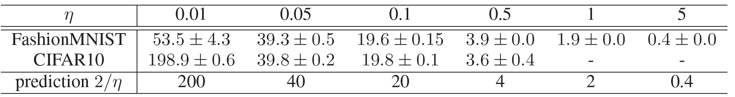
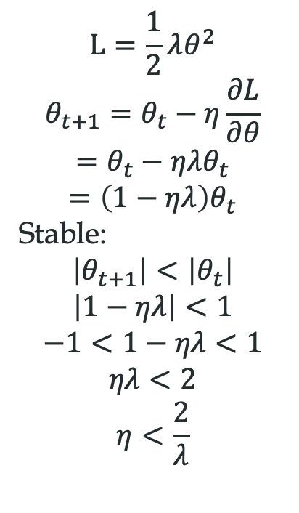
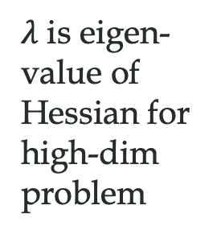
Edge of stability
$$L=\frac{1}{2}λθ^{2}$$
$$θ_{t+1}=θ_{t}−η\frac{∂L}{∂θ}$$
$$=θ_{t}−ηλθ_{t}$$
$$=\left(1−ηλ\right)θ_{t}$$
Stable:
$$\left|θ_{t+1}\right|<\left|θ_{t}\right|$$
$$\left|1−ηλ\right|<1$$
$$−1<1−ηλ<1$$
$$ηλ<2$$
$$η<\frac{2}{λ}$$
$λ$ is eigen-value of Hessian for high-dim problem
https://www.enjoyalgorithms.com/blog/loss-and-cost-functions-in-machine-learning
Edge of stability
Wu, Ma, E, NeurIPS, 2018

Slide 25
Sharpness effect

Slide 26
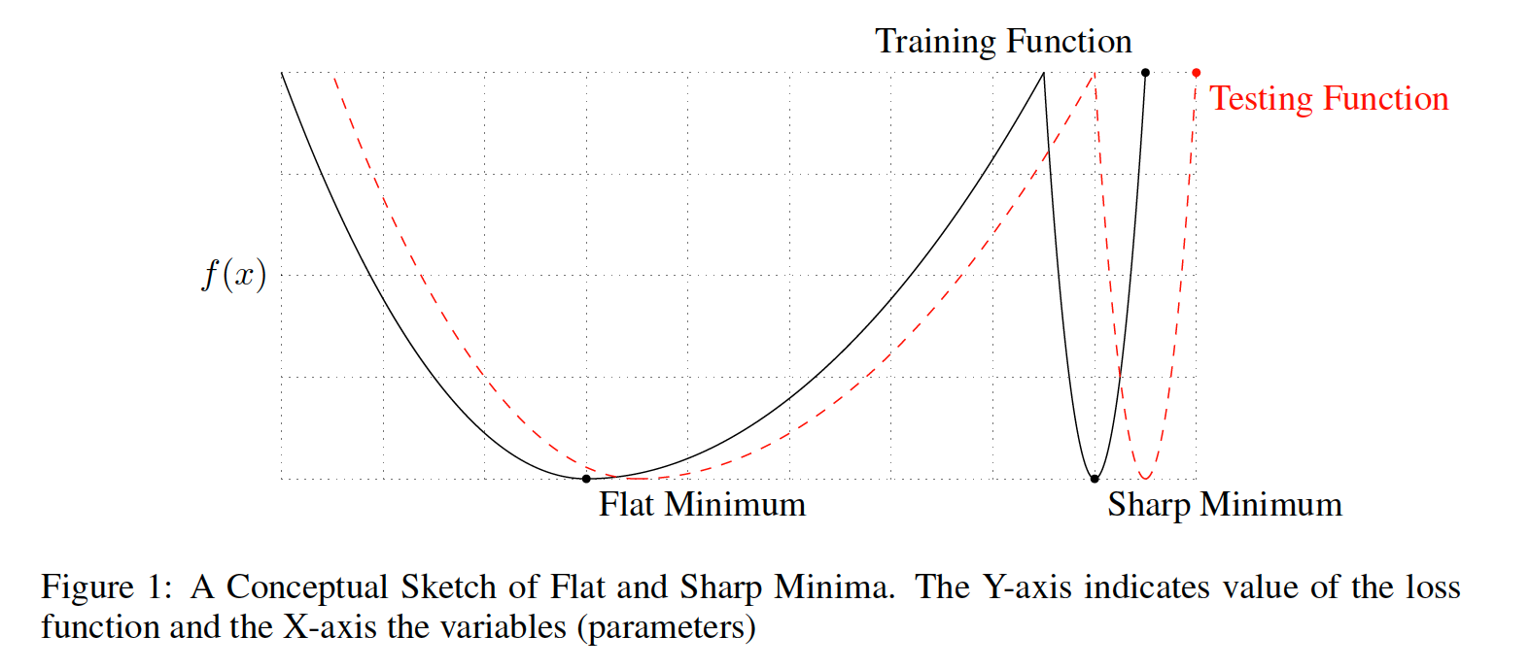
Sharpness effect

Slide 27
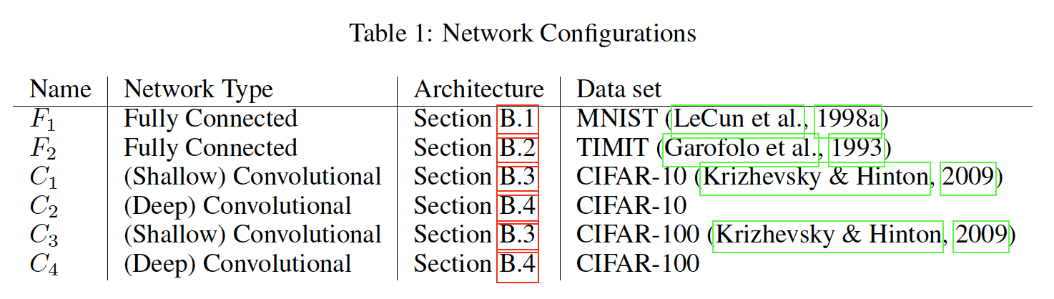
Experiment list

Slide 28
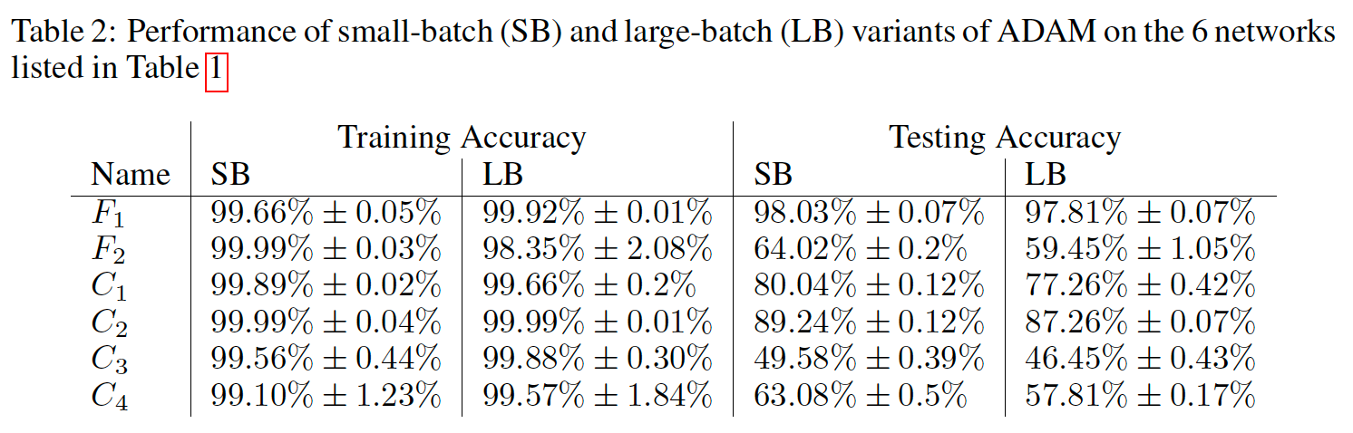
Experiment list
For all experiments, we used 10% of the training data as batch size for the large-batch experiments and 256 data points for small-batch experiments.

Slide 29
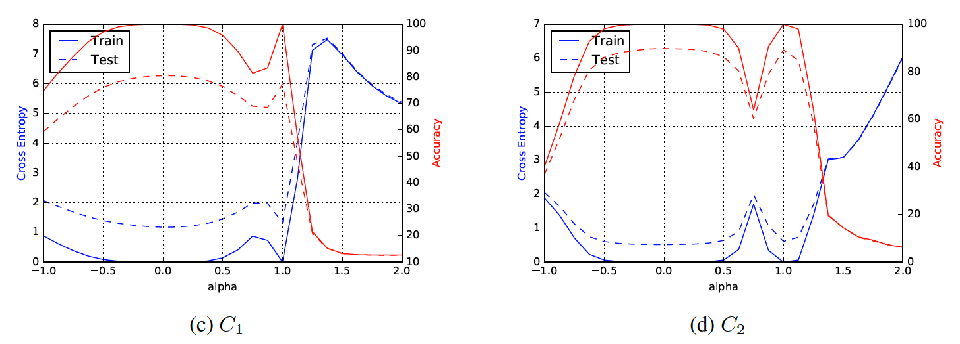
1d cross section
0 corresponds to the SB minimizer and 1 to the LB minimizer.

Slide 30
Condensation 凝聚现象

Slide 31
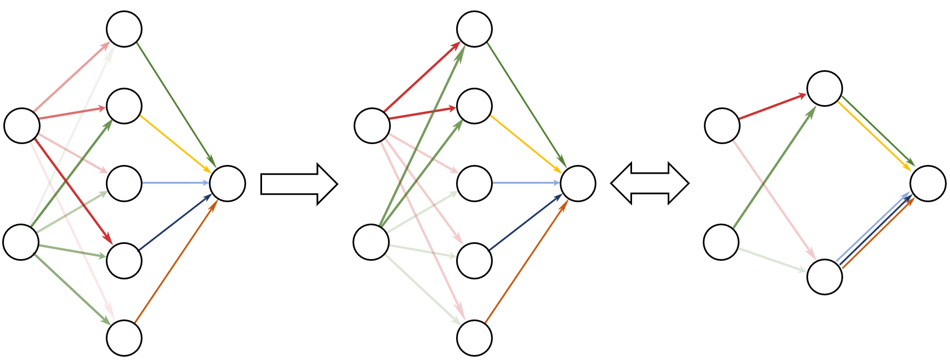
Condensation
Initial: Neurons different
After training: Clustered
Effective small net
Condense
Embedding
Luo#, Xu#, Ma, Zhang*, JMLR, 2021

